Slide 1
Networks
Example: elevator controller.

Slide 2
Terminology
Elevator car: holds passengers.
Hoistway: elevator shaft.
Car control panel: buttons in each car.
Floor control panel: elevator request, etc. per floor.

Slide 3
Elevator system
floor
floor
floor
floor
floor
Hoistway 1
Hoistway 2

Slide 4
Theory of operation
Each floor has control panel, display.
Each car has control panel:
  one button per floor;
  emergency stop.
Controlled by a single controller.

Slide 5
Elevator position sensing
sensor
fine
coarse

Slide 6
Elevator control
Elevator control has up and down.
  To stop, disable both.
Master controller:
  reads elevator positions;
  reads requests;
  schedules elevators;
  controls movement;
  controls doors.

Slide 7
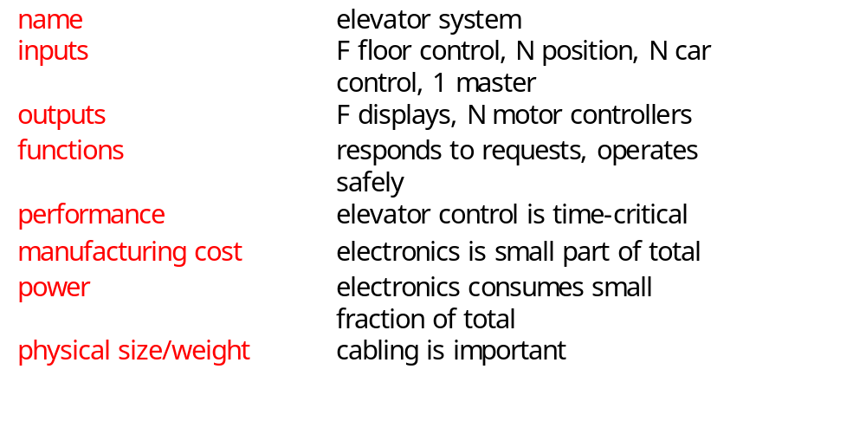
Elevator system requirements

Slide 8
Elevator system class diagram
1
Coarse-sensor*
Master-control-panel*
1
1
1
N
1
Fine-sensor*
Car
1
1
1
1
Controller
1
Car-control-panel*
1
1
1
Floor
F
N
Floor-control-panel*
Motor*
1

Slide 9
Physical interfaces
Sensor*
Car-control-panel*
hit: boolean
Floors[1..F]: boolean
emergency-stop:
boolean
open-door, close-door:
boolean
Coarse-sensor*
Fine-sensor*
Master-control-panel...
Motor*
Floor-control-panel*
speed: {o,s,f}
up, down: boolean

Slide 10
Car and Floor classes
Car
Floor
request-lights[1..F]:
boolean
current-floor: integer
up-light, down-light:
boolean

Slide 11
Controller class
Controller
car-floor[1..H]: integer
emergency-stop[1..H]:
integer
scan-cars()
scan-floors()
scan-master-panel()
operate()

Slide 12
Architecture
Computation and I/O occur at:
  floor control panels/displays;
  elevator cars;
  system controller.

Slide 13
Panels and cab controller
Panels are straightforward---no real-time requirements.
Cab controller:
  read buttons and send events to system controller;
  read sensor inputs and send to system controller.

Slide 14
System controller
Must take inputs from many sources:
  car controllers;
  floors.
Must control cars to hard real-time deadlines.
User interface, scheduling are soft deadlines.

Slide 15
Testing
Build an elevator simulator using an FPGA:
  simulate multiple elevators;
  simulate real-time control demands.

